Slide 1
ReactJS
about new

Slide 2
Recap
Props is read only and is received by component
State can be mutated and is managed by the smart component
State is updated via the setState method
Data flow is one way only

Slide 3
Recap
Components have different life cycle methods that can be overridden
You can force a component to render using forceUpdate()
You can pass functions as event handlers for tag events like onClick and onChange

Slide 4
Recap
Components have different life cycle methods that can be overridden
You can force a component to render using forceUpdate()
You can pass functions as event handlers for tag events like onClick and onChange

Slide 5
Thinking in React
about new

Slide 6
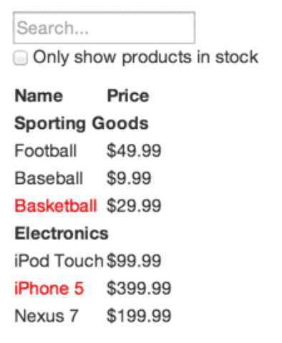
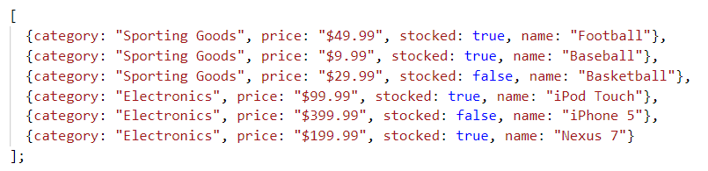
Thinking in React

Slide 7
How to think in ReactJS
Step 1: Break The UI Into A Component Hierarchy
Step 2: Build A Static Version in React
Step 3: Identify The Minimal (but complete) Representation Of UI State
Step 4: Identify Where Your State Should Live
Step 5: Add Inverse Data Flow

Slide 8
Step 1: Break The UI Into A Component
Draw boxes around every component and subcomponent
Take note of the single responsibility principle
Ideally one component should focus in doing 1 thing, if its continue to grow, decompose it to smaller ones
Notes:
Single responsibility principle is a computer programming principle that states that every module, class, or function[1] should have responsibility over a single part of the functionality provided by the software, and that responsibility should be entirely encapsulated by the class

Slide 9
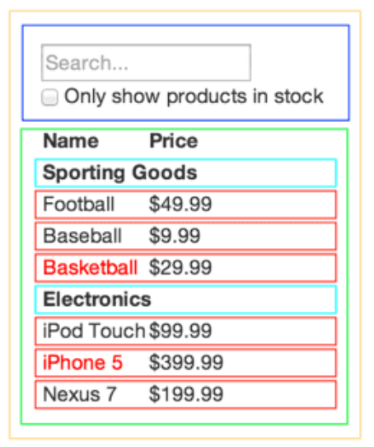
Step 1: Break The UI Into A Component
FilterableProductTable (orange): contains the entirety of the example
SearchBar (blue): receives all user input
ProductTable (green): displays and filters the data collection based on user input
ProductCategoryRow (turquoise): displays a heading for each category
ProductRow (red): displays a row for each product

Slide 10
Step 1: Break The UI Into A Component
FilterableProductTable
SearchBar
ProductTable
ProductCategoryRow
ProductRow (red)

Slide 11
Step 2: Build A Static Version in React
Build top-down or bottom-up
For small and simple applications its convenient to go top-down
For very big projects, bottom-up is more convenient since we can write tests as we build up
Notes:
Single responsibility principle is a computer programming principle that states that every module, class, or function[1] should have responsibility over a single part of the functionality provided by the software, and that responsibility should be entirely encapsulated by the class

Slide 12
Step 3: Identify The Minimal (but complete) Representation Of UI State
Think of the minimal set of mutable state that your app needs.
The key here is DRY: Don’t Repeat Yourself.
Figure out the absolute minimal representation of the state your application needs and compute everything else you need on-demand.

Slide 13
Step 3: Identify The Minimal (but complete) Representation Of UI State
For example, if you’re building a TODO list, just keep an array of the TODO items around; don’t keep a separate state variable for the count. Instead, when you want to render the TODO count, simply take the length of the TODO items array.

Slide 14
Step 3: Identify The Minimal (but complete) Representation Of UI State
Think of all of the pieces of data in our example application. We have:
The original list of products
The search text the user has entered
The value of the checkbox
The filtered list of products

Slide 15
Step 3: Identify The Minimal (but complete) Representation Of UI State
Let’s go through each one and figure out which one is state. Simply ask three questions about each piece of data:
Is it passed in from a parent via props? If so, it probably isn’t state.
Does it remain unchanged over time? If so, it probably isn’t state.
Can you compute it based on any other state or props in your component? If so, it isn’t state.

Slide 16
Step 3: Identify The Minimal (but complete) Representation Of UI State
The original list of products is passed in as props, so that’s not state. The search text and the checkbox seem to be state since they change over time and can’t be computed from anything. And finally, the filtered list of products isn’t state because it can be computed by combining the original list of products with the search text and value of the checkbox.
So finally, our state is:
The search text the user has entered
The value of the checkbox

Slide 17
Step 4: Identify Where Your State Should
Live
We need to identify which component mutates, or owns, this state.
Remember: React is all about one-way data flow down the component hierarchy.

Slide 18
Step 4: Identify Where Your State Should
Live
It may not be immediately clear which component should own what state. This is often the most challenging part for newcomers to understand, so follow these steps to figure it out:
Identify every component that renders something based on that state.
Find a common owner component (a single component above all the components that need the state in the hierarchy).

Slide 19
Step 4: Identify Where Your State Should
Live
Either the common owner or another component higher up in the hierarchy should own the state.
If you can’t find a component where it makes sense to own the state, create a new component simply for holding the state and add it somewhere in the hierarchy above the common owner component.

Slide 20
Step 4: Identify Where Your State Should
Live
ProductTable needs to filter the product list based on state and SearchBar needs to display the search text and checked state.
The common owner component is FilterableProductTable.
It conceptually makes sense for the filter text and checked value to live in FilterableProductTable

Slide 21
Step 4: Identify Where Your State Should
Live
ProductTable needs to filter the product list based on state and SearchBar needs to display the search text and checked state.
The common owner component is FilterableProductTable.
It conceptually makes sense for the filter text and checked value to live in FilterableProductTable

Slide 22
Step 5: Add Inverse Data Flow
Since FilterableProductTable is where the state resides this is also where the state should be changed
We need to pass callbacks to the SearchBar that will fire whenever the state is updated.
We can use the onChange event to update the inputs
The passed functions will call setState then the app will be updated

Slide 23
Recap
Steps in creating design a React application
Step 1: Break The UI Into A Component Hierarchy
Step 2: Build A Static Version in React
Step 3: Identify The Minimal (but complete) Representation Of UI State
Step 4: Identify Where Your State Should Live
Step 5: Add Inverse Data Flow

Slide 24
Routing
about new

Slide 25

Routing
We need a separate package (react-router-dom) for routing since ReactJS is only used for rendering
https://reacttraining.com/react-router/web/example/basic

Slide 26
Routing
Instead of <a href="/"> we use <Link to="/">
To route, your components should be enclosed by a Router component from the package
To render a component based on the current route, insert the component inside the Route component
See code examples

Slide 27
Redux
about new

Slide 28
Managing State
A component should manage its own state
Imagine building a very big react application where many components will need the state of other components, managing state would be a nightmare
This is the problem Redux is trying to solve: it helps giving each React component the exact piece of state it needs.

Slide 29
Redux
Redux is a node module that can also be used to other node projects like ReactJS. It is platform agonistic
Redux holds up the state within a single location.
Logic for fetching and managing the state lives outside React

Slide 30
Redux
Redux can be intimidating but not that hard
You need redux if:
multiple React components needs to access the same state but do not have any parent/child relationship
you start to feel awkward passing down the state to multiple components with props

Slide 31
Redux Store
store - state of the whole application lives inside the store
Instead of the state being in each component, it now resides in the store
A reducer is just a JavaScript function. A reducer takes two parameters: the current state and an action. Its main job is to update the store.

Slide 32
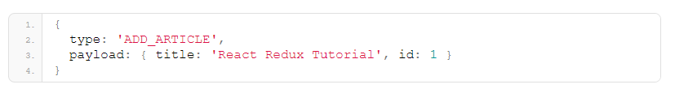
Redux Store
Redux actions are nothing more than JavaScript objects
Every action needs a type property for describing how the state should change.

Slide 33
Redux Store
Demo

Slide 34
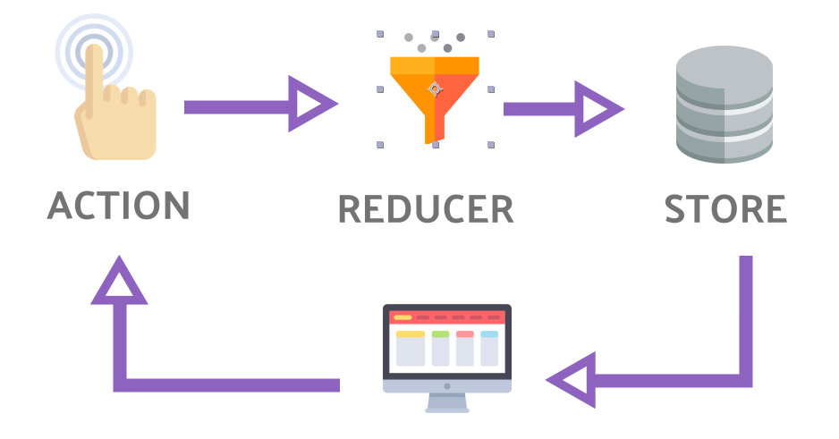

Slide 35
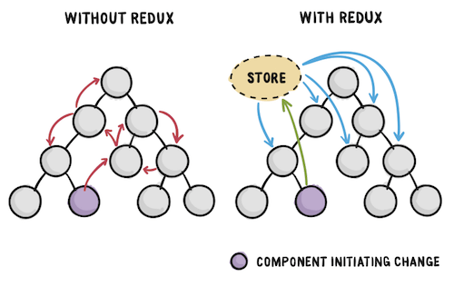

Slide 36
